Slide 1
Revolutionizing Wellness Prognostication: A Futuristic Health Predictor
Submitted in the partial fulfillment for the award of the degree of
BACHELOR OF ENGINEERING
IN
COMPUTER SCIENCE ENGINEERING WITH SPECIALIZATION IN
Artificial Intelligence and Machine Learning
Submitted by:
Sarthak Jain 20BCS6689
Kailash Kumar Dewangan 20BCS6676
Aryan Singh 20BCS6677
Saransh Gupta 20BCS6662
Under the Supervision of:
Dr. Priyanka Kaushik
Department of AIT-CSE
DISCOVER . LEARN . EMPOWER

Slide 2
Outline
Introduction to Project
Problem Formulation
Objectives of the work
Methodology used
Results and Outputs
Conclusion
Future Scope
References

Slide 3
Introduction to Project
Health Status Detection using machine learning is a research area that aims to predict the health status of individuals based on their health condition data. The use of machine learning algorithms has the potential to improve the accuracy and speed of diagnosis and treatment, as well as enable personalized healthcare.
In this research paper, we present a synopsis of recent developments in health status detection using machine learning, including data preprocessing techniques, feature selection, and classification models.
We also discuss the challenges and limitations of current methods, as well as opportunities for future research in this exciting and rapidly evolving field. Overall, this research paper provides a comprehensive overview of the current state of the art in health status detection using machine learning, and highlights its potential to transform healthcare delivery.

Slide 4
Problem Formulation
The Project is aimed at studying the existing systems that are aimed at predicting Health Status based on dataset and analysing the techniques and methodologies used. This would help develop an insight on the effectiveness of each model as well as shortcomings of each technique.
Detecting the health status of individuals using available data sources.
Objective: Develop a model that accurately classifies individuals as healthy or unhealthy based on available data sources.
Inputs:
Symptom
Weight
Constraints:
interpretable
explainable

Slide 5
Problem Formulation
SVM: Diabetes, Breast Cancer, Heart Disease, Hypertension, Parkinson's Disease, Prostate Cancer
RF: Breast Cancer, Diabetes, Heart Disease, Hemoglobin variants, Lung Cancer, micro RNA
DT: Breast Cancer, Cerebral infarction, Hemoglobin variants, Heart Disease, Kidney Disease
NB: Asthma, Heart Disease, Prostate Cancer
ANN: Breast Cancer, Heart Disease, Stroke
KNN: Heart Disease, Parkinson's Disease.
LR: Heart Disease, Liver Disease

Slide 6
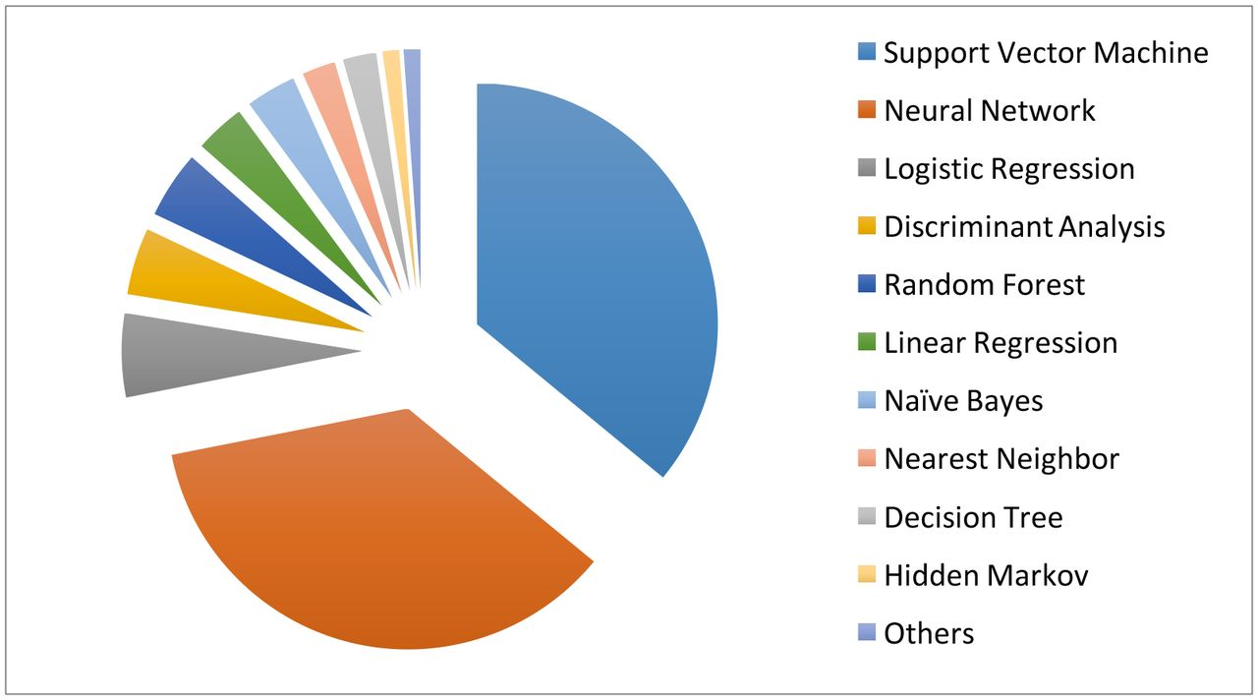
The popularity of the various supervised learning techniques in medical applications, which clearly shows that SVM and neural network are the most popular ones.

Slide 7
Objectives of the Work
The objectives of the project can be summarized as follows;
To conduct a study of the research on this field, to view the variability in the findings and understand the current scope in the field of health status detection.
To explore and work on the datasets, suitable for building the model to test techniques to classify the diseases of the patients.
Make use of libraries like Numpy, Pandas, Sklearn, Matlplotlib to extract and customize information to yield valuable insights on the Health Status from the document.
Test various models on the pre-processed text to obtain the results, which are then to be compared to the existing knowledge to test the accuracy of the models.
To write the findings and journal the details in the form of a research.

Slide 8
Methodology used
Collecting Data:
We get data in form of .xlsx files in Microsoft excel or text files. But are gathering the data from various sources for our model for a better prediction and better accuracy of our model. The more the data the higher the accuracy of the model and the accuracy of the model depends on the quality of data.
2) Preparing the data.
The quality of the data used in any analytical procedure is critical. It is imperative to allot time and effort to establish data qualities and then prepare a model to address problems of missing data and outlier handling. Exploratory analysis is one approach for delving deeper into the subtleties of the data and so expanding the nutritional content.

Slide 9
3) Training a model,
This step entails determining the best method and data representation in the form of a model. The cleaned data is divided into two parts: train and test (proportions vary depending on prerequisites), with the first (training data) being used to create the model. The second section (test data) serves as a guide.
4) Evaluating the model.
We need to test our model based on algorithms. Working and using algorithms and testing them for using the maximum efficient algorithm on our data set depending on our use and requirement.
5) Improving the performance.
Using the algorithms which give maximum efficient, best results and highest accuracy for given dataset. Thus, the developed model would be efficient and adaptive for the data which is going to be stored and processed.

Slide 10
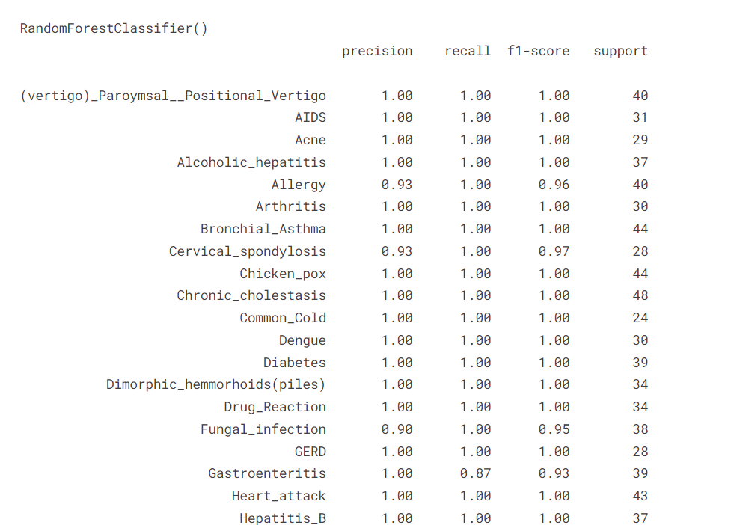
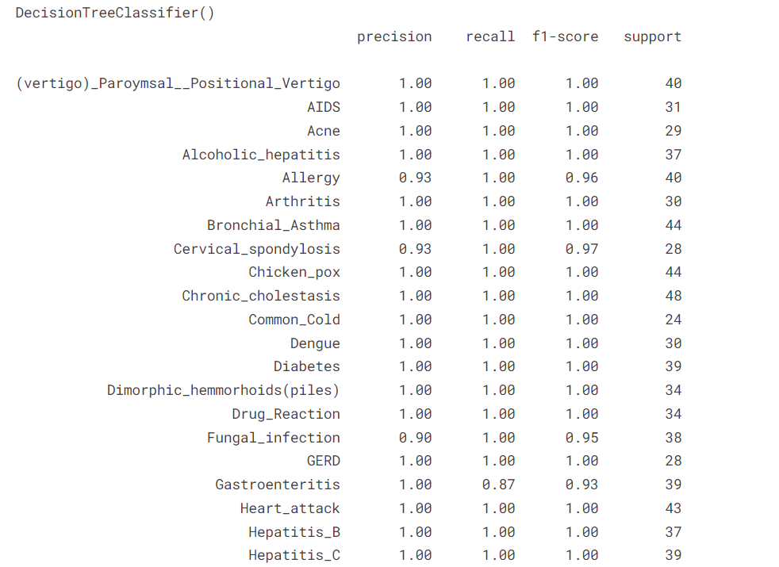
Results and Outputs: .
Comparing the accuracy between tree and different algorithm.
Tree Algorithms

Slide 11
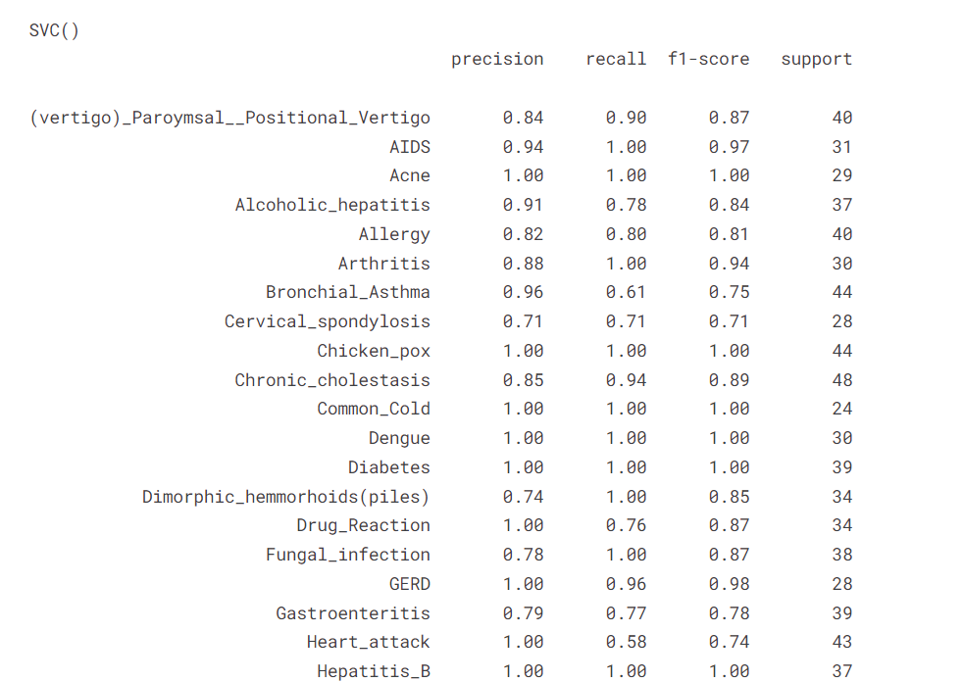

Slide 12
Conclusion
Concluded the health status using double Tree Classifiication algorithm and Support vector machine
Predicted the symptoms, precautions to be taken, and their weights.

Slide 13
Future Scope
To deploy the machine learning project in real life.
To approach several hospitals for their datasets and then try our models on their dataset as their dataset would be accurate and real in life.

Slide 14
References
[1]https://www.ahajournals.org/doi/full/10.1161/CIRCOUTCOMES.118.005114
[2]https://bmcresnotes.biomedcentral.com/articles/10.1186/1756-0500-4-299
[3] https://svn.bmj.com/content/2/4/230
[4] https://www.ncbi.nlm.nih.gov/pmc/articles/PMC5391725/
[5] https://www.ncbi.nlm.nih.gov/pmc/articles/PMC8822225/
[6] https://pubmed.ncbi.nlm.nih.gov/31304302/

Slide 15


